Slide 1




Product-oriented Machine Translation with Cross-modal Cross-lingual Pre-training
Yuqing Song¹, Shizhe Chen², Qin Jin¹, Wei Luo³, Jun Xie³, Fei Huang³
¹Renmin University of China, ²INRIA, ³Alibaba DAMO Academy
{syuqing, qjin}@ruc.edu.cn, shizhe.chen@inria.fr,
{muzhuo.lw, qingjing.xj, f.huang}@alibaba-inc.com

Slide 2


Introduction
Product-oriented Machine Translation (PMT)
What is the PMT ?
E-commercial product descriptions need to be translated into various languages for international e-commerce.
Such translation scenario is called as PMT.
Example from the shopping website https://www.nordstrom.com/

Slide 3
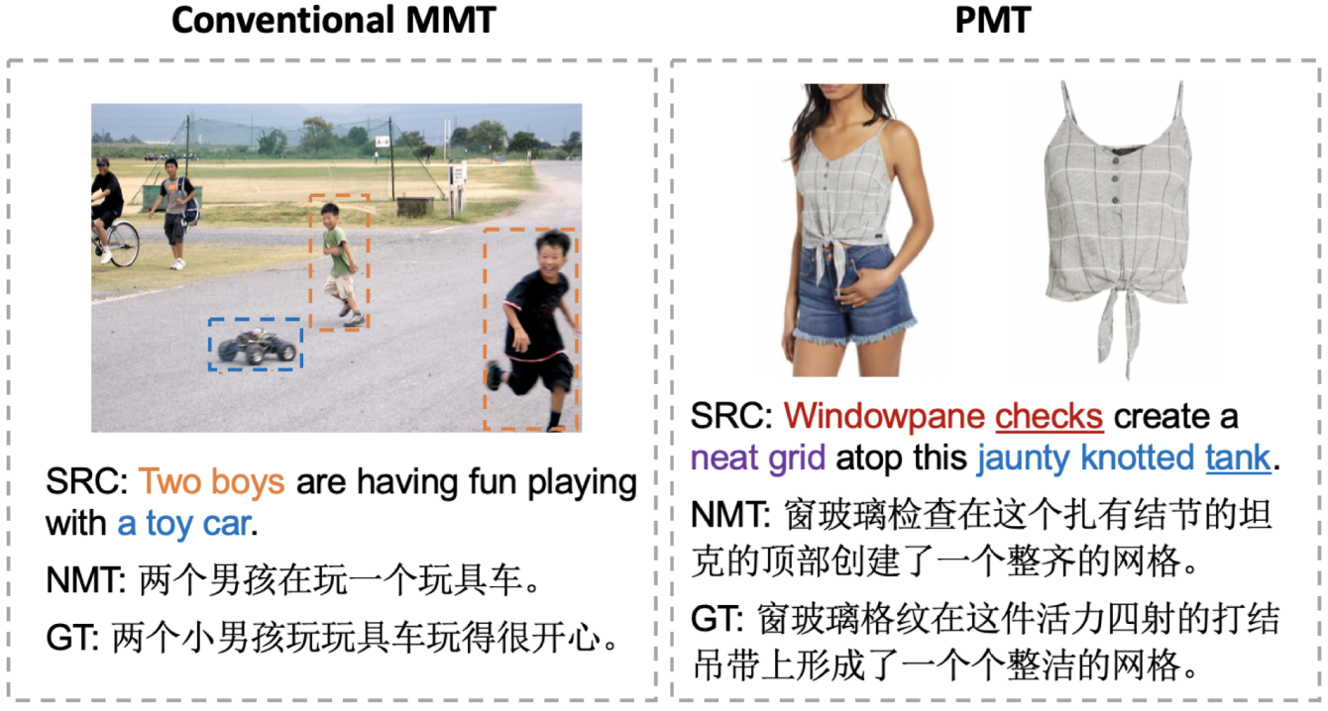
Introduction
Product-oriented Machine Translation (PMT)
What is the PMT ?
E-commercial product descriptions need to be translated into various languages for international e-commerce.
Such translation scenario is called as PMT.
How is the PMT different with NMT or MMT ?
Product descriptions contain specialized jargons, which are ambiguous in different contexts. (vs. NMT)
The relevance between product image and text description is more complex than that in MMT. (vs. MMT)
Existing resources for PMT are rather limited.
The challenges of PMT task compared with NMT and MMT tasks

Slide 4
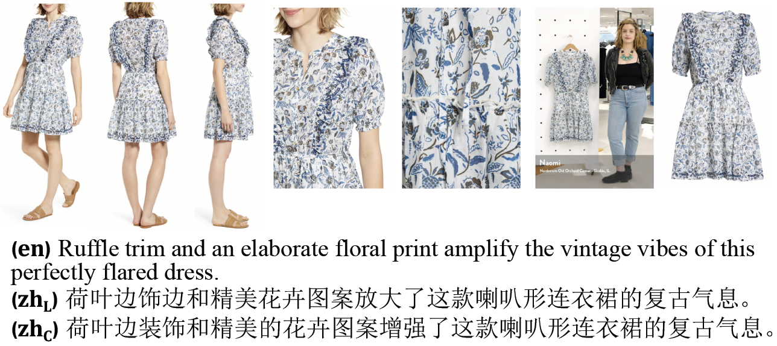
Fashion-MMT
Fashion-MMT Dataset: A large-scale bilingual PMT dataset
Based on the FACAD[1], which contains ~120K English product descriptions with images crawled from the Nordstrom website.
Data Annotation
Automatically translate all the English descriptions into Chinese with Google translation system. The noisy bilingual pair with images are denoted as the Fashion-MMT(L).
Manually clean a subset of Fashion-MMT(L) by post-editing the automatic Chinese translations, denoted as the Fashion-MMT(C).
[1] Yang et al. Fashion Captioning: Towards Generating Accurate Descriptions with Semantic Rewards, ECCV 2020

Slide 5
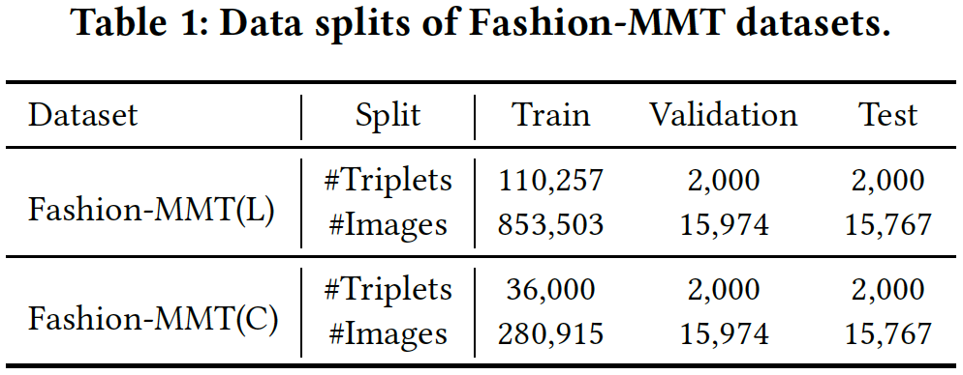
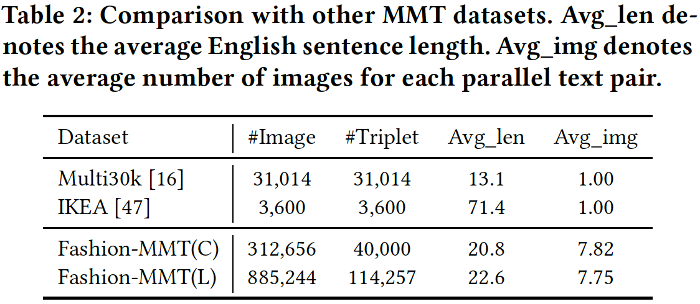
Fashion-MMT
Fashion-MMT Dataset: A large-scale bilingual PMT dataset
Data Statistics
The clean version contains 40,000 triplets, with 36,000 for training, 2,000 for validation and 2,000 for test.
Both of the Fashion-MMT(L) and Fashion-MMT(C) are larger than the Multi30k benchmark and commercial domain IKEA dataset.
For each parallel pair in Fashion-MMT, there are multiple images associate with it.

Slide 6
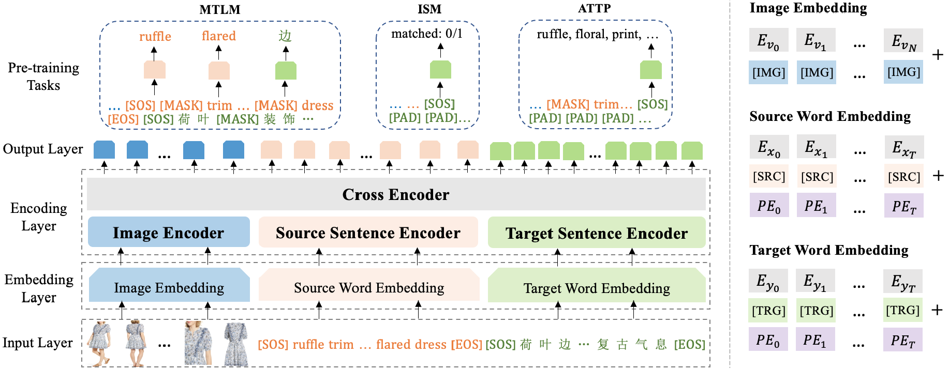
Method
Motivation
Two key-points of PMT or MMT
Learning cross-lingual correspondence for translation
Learning cross-modal correspondence for better translation
UPOC²: A Unified Product Oriented Cross-lingual Cross-modal model
Only optimized with the ground-truth translation is not enough !

Slide 7
Method
Model Architecture
Input sequence: Image-Source-Target triplet
Independent encoders: capture intra-context information
Cross encoder: capture inter-context across different modalities and languages
Pre-training Tasks
Multimodal Translation Language Modeling (MTLM)
Image Source-sentence Matching (ISM)
Product Attribute Prediction (ATTP)

Slide 8

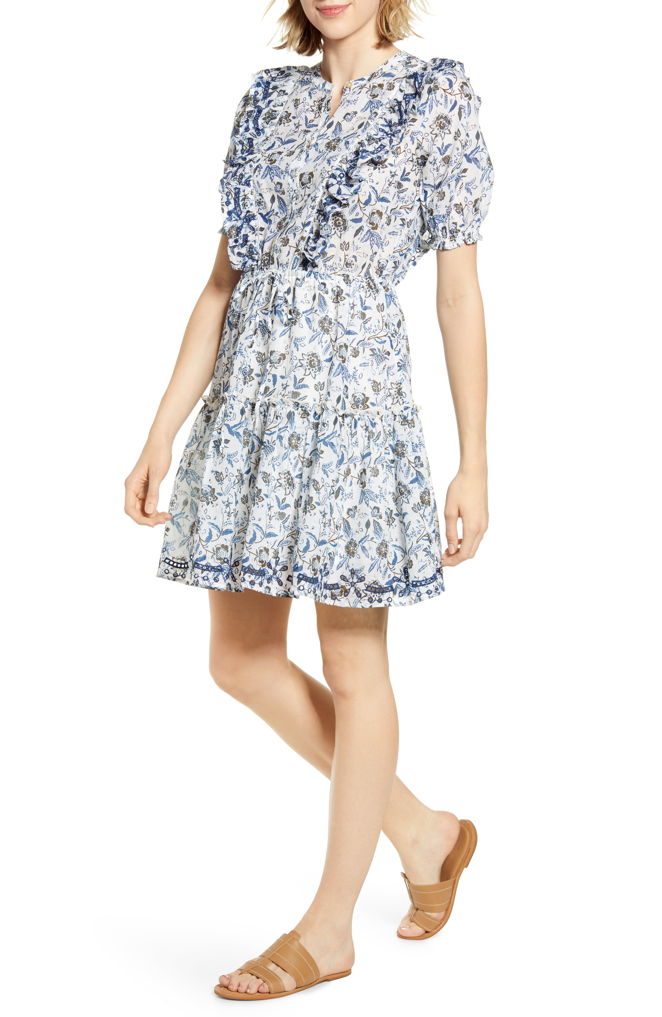
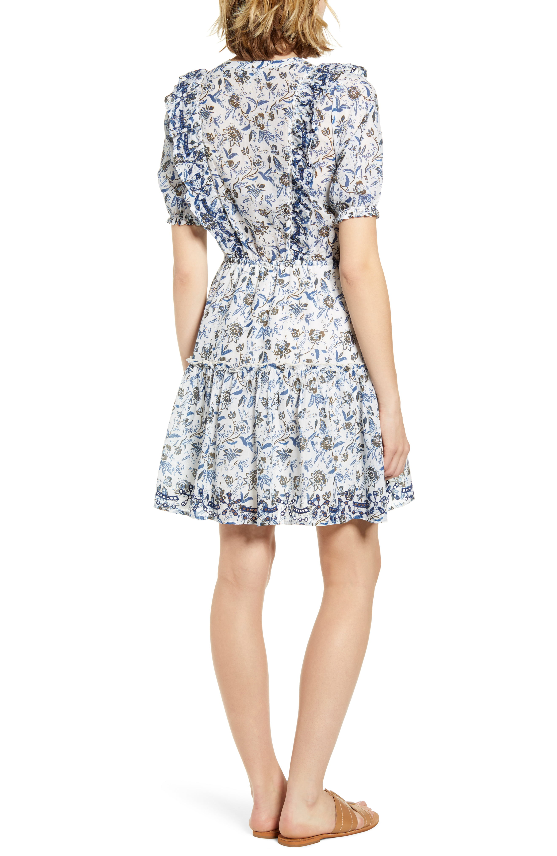
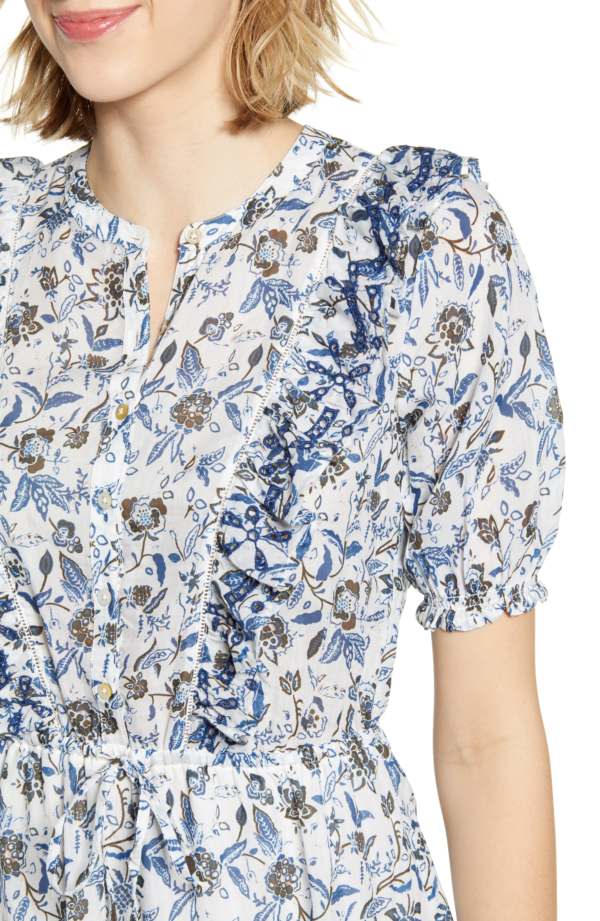
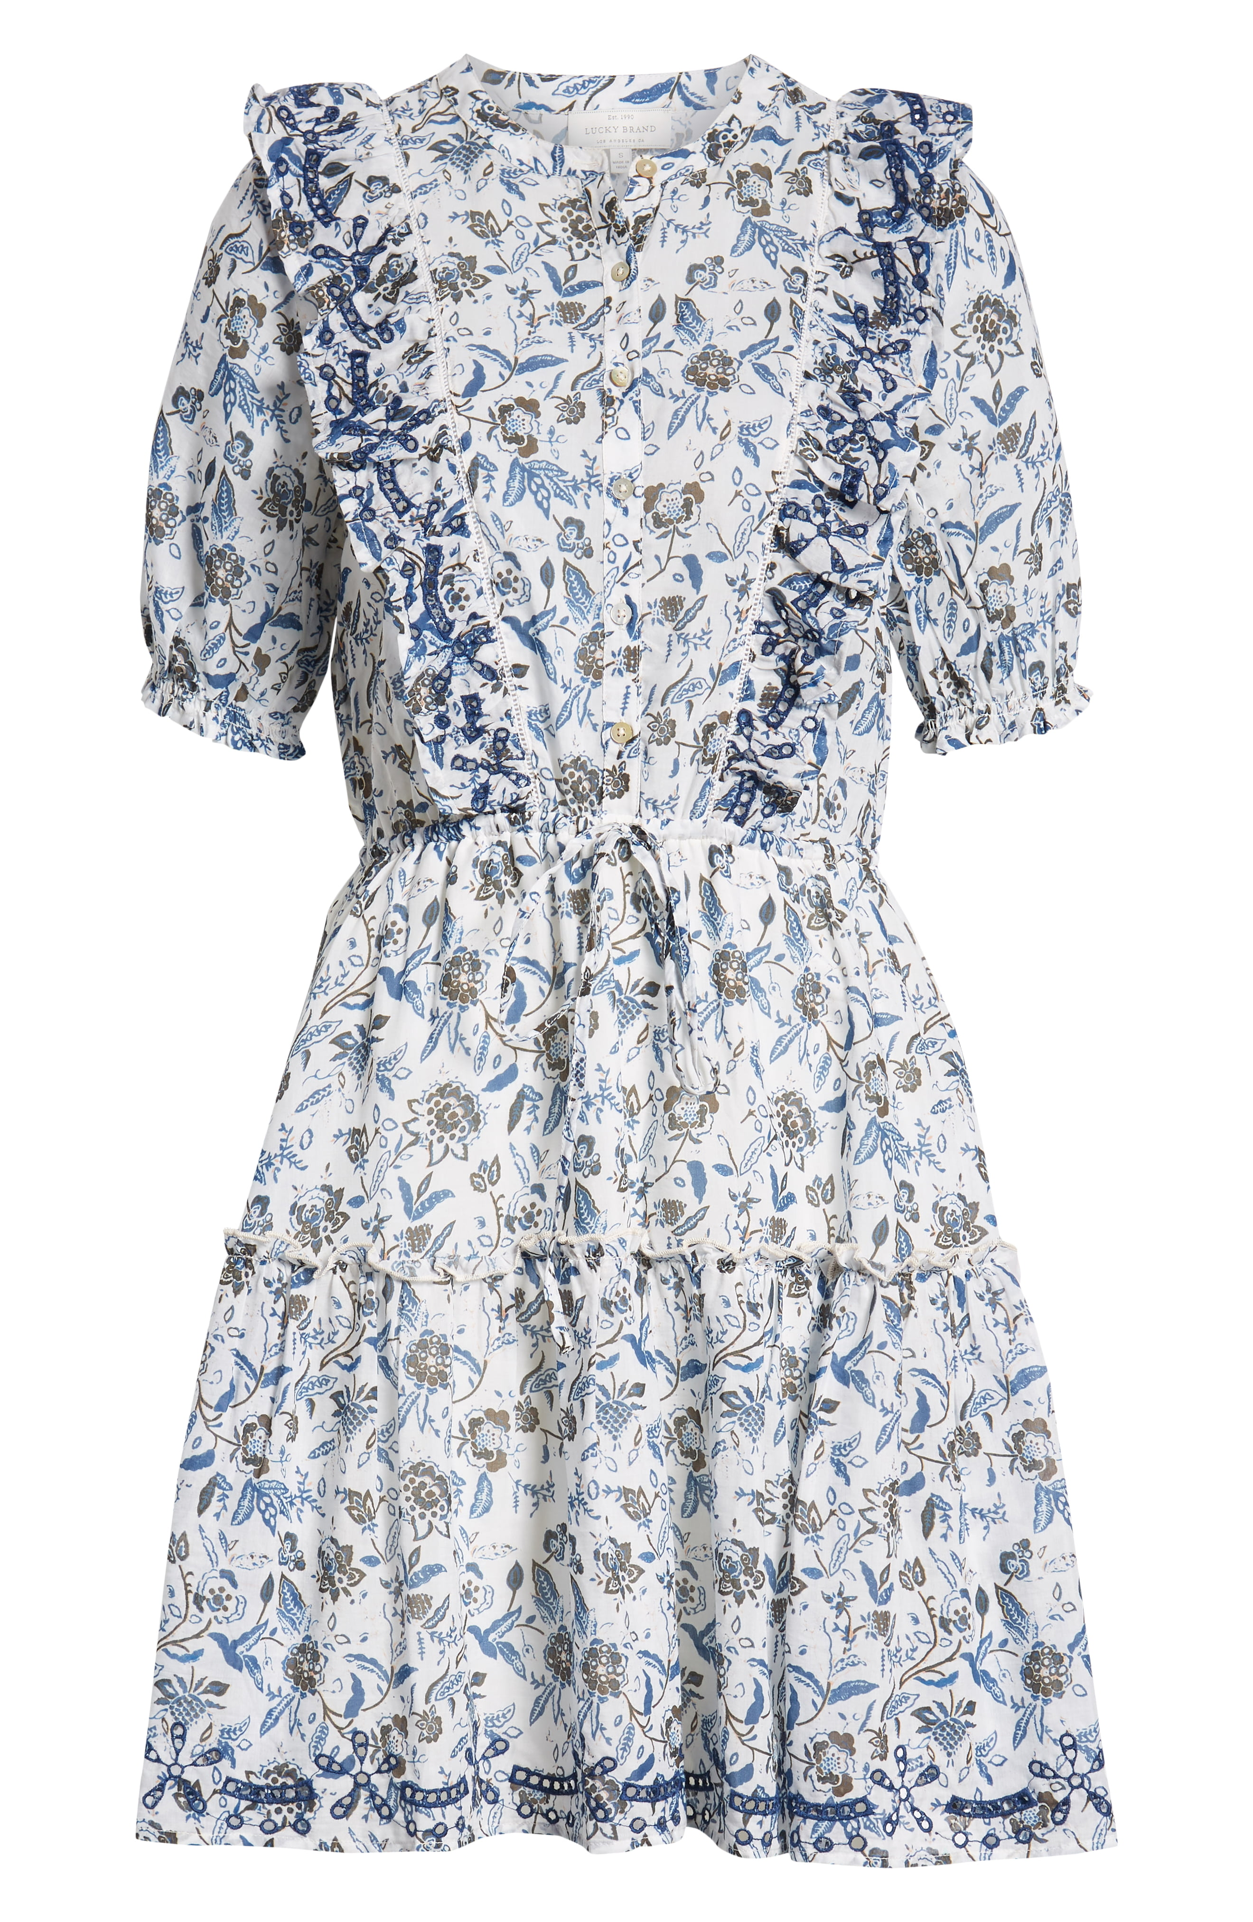
Method
Task I: Multimodal Translation Language Modeling (MTLM)
ruffle
dress
边
Output Layer
…
…
…
Cross Encoder
Encoding Layer
Randomly choose 15% tokens in source and target sentences for prediction
Image Encoder
Source Sentence Encoder
Target Sentence Encoder
Embedding Layer
Image Embedding
Source Word Embedding
Target Word Embedding
Input Layer
…
[SOS] [MASK] trim … [MASK] [EOS]
[SOS] 荷 叶 [MASK] … 气 息 [EOS]

Slide 9

Method
Task II: Image Source-sentence Matching (ISM)
0/1
Output Layer
…
…
…
Cross Encoder
Encoding Layer
Pad the target language sentence and predict if the images and source sentence are matched
Image Encoder
Source Sentence Encoder
Target Sentence Encoder
Embedding Layer
Image Embedding
Source Word Embedding
Target Word Embedding
Input Layer
…
[SOS] ruffle trim … flared dress [EOS]
[SOS] [PAD] … [PAD] [PAD] [PAD]

Slide 10
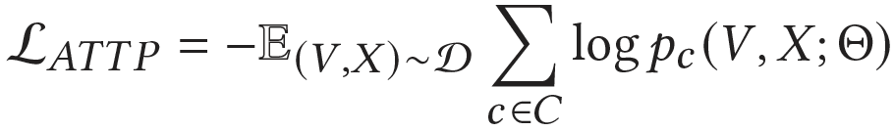
Method
Task III: Product Attribute Prediction (ATTP)
ruffle, floral, print
Output Layer
…
…
…
Cross Encoder
Encoding Layer
Image Encoder
Source Sentence Encoder
Target Sentence Encoder
Extend the two-class classification to a
multi-class classification
Embedding Layer
Image Embedding
Source Word Embedding
Target Word Embedding
Input Layer
…
[SOS] [MASK] trim … dress [EOS]
[SOS] [PAD] … [PAD] [PAD] [PAD]

Slide 11

Method
Fine-tuning: adapt to the PMT task
边
Output Layer
…
…
…
Cross Encoder
Encoding Layer
Only predict the target language tokens and constrain the attention masks for inference
Image Encoder
Source Sentence Encoder
Target Sentence Encoder
Embedding Layer
Image Embedding
Source Word Embedding
Target Word Embedding
Input Layer
…
[SOS] ruffle trim … flared dress [EOS]
[SOS] 荷 叶 [MASK] … 气 息 [EOS]

Slide 12
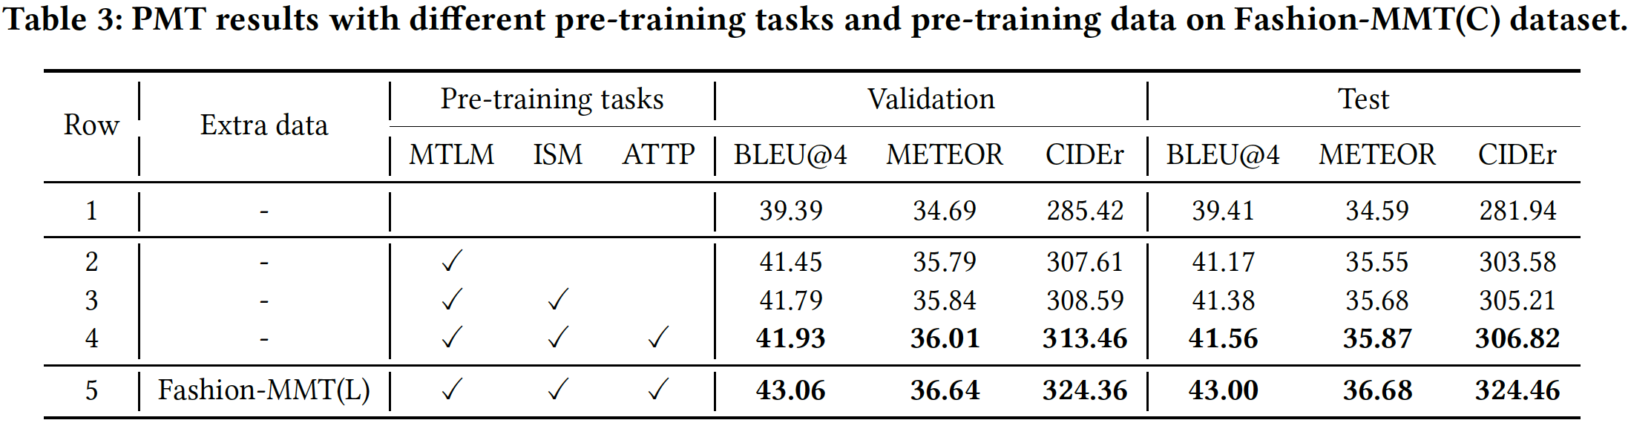
Results
Ablation study on the Fashion-MMT dataset
Even pre-trained on the same dataset, the pre-trained model significantly outperform non-pretrain baseline.
Each pre-training task shows benefit to the PMT downstream task.
With more noisy data for pre-training, the model significantly achieves more gains.

Slide 13
Results
Ablation study on the Fashion-MMT dataset
Even pre-trained on the same dataset, the pre-trained model significantly outperform non-pretrain baseline.
Each pre-training task shows benefit to the PMT downstream task.
With more noisy data for pre-training, the model significantly achieves more gains.

Slide 14
Results
Ablation study on the Fashion-MMT dataset
Even pre-trained on the same dataset, the pre-trained model significantly outperform non-pretrain baseline.
Each pre-training task shows benefit to the PMT downstream task.
With more noisy data for pre-training, the model significantly achieves more gains.

Slide 15
Results
Ablation study on the Fashion-MMT dataset
Even pre-trained on the same dataset, the pre-trained model significantly outperform non-pretrain baseline.
Each pre-training task shows benefit to the PMT downstream task.
With more noisy data for pre-training, the model significantly achieves more gains.

Slide 16
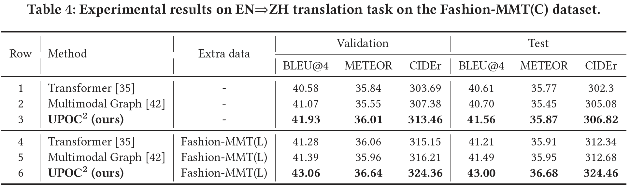
Results
Comparisons with other SoTA models on the Fashion-MMT dataset
The state-of-the-art MMT model improves the text-only model limitedly on the PMT dataset.
Our model outperforms the state-of-the-art NMT and MMT models even without any extra data.
The pre-trained model can better utilize noisy data while the task-specific models improve limitedly.

Slide 17
Results
Comparisons with other SoTA models on the Fashion-MMT dataset
The state-of-the-art MMT model improves the text-only model limitedly on the PMT dataset.
Our model outperforms the state-of-the-art NMT and MMT models even without any extra data.
The pre-trained model can better utilize noisy data while the task-specific models improve limitedly.

Slide 18
Results
Comparisons with other SoTA models on the Fashion-MMT dataset
The state-of-the-art MMT model improves the text-only model limitedly on the PMT dataset.
Our model outperforms the state-of-the-art NMT and MMT models even without any extra data.
The pre-trained model can better utilize noisy data while the task-specific models improve limitedly.

Slide 19
Results
Comparisons with other SoTA models on the Fashion-MMT dataset
The state-of-the-art MMT model improves the text-only model limitedly on the PMT dataset.
Our model outperforms the state-of-the-art NMT and MMT models even without any extra data.
The pre-trained model can better utilize noisy data while the task-specific models improve limitedly.

Slide 20
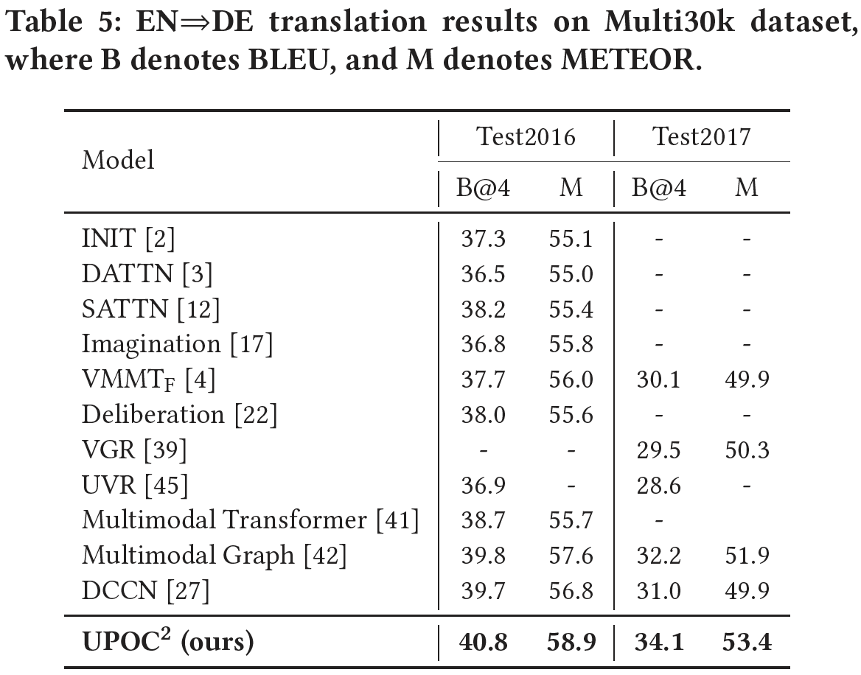
Results
Comparisons with other SoTA models on the Multi30k dataset
Even without any extra data, our model also achieves the state-of-the-art MMT results on the Multi30k dataset .

Slide 21
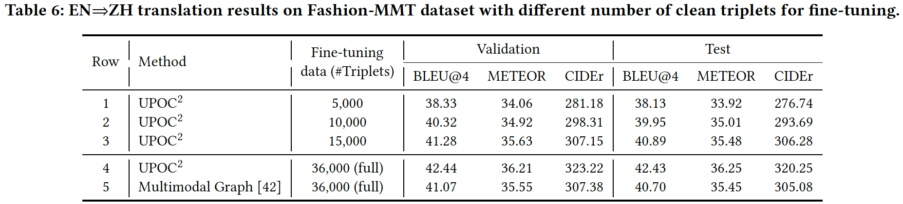
Results
Lower resource learning results on the Fashion-MMT dataset
First pre-training the model on the noisy data can alleviate the demand of clean annotations.
With only 40% annotated data used, our model achieves comparable results with the SoTA model.
Our pre-trained model shows more advantages on such lower resource learning situation.

Slide 22
Results
Lower resource learning results on the Fashion-MMT dataset
First pre-training the model on the noisy data can alleviate the demand of clean annotations.
With only 40% annotated data used, our model achieves comparable results with the SoTA model.
Our pre-trained model shows more advantages on such lower resource learning situation.

Slide 23
Results
Lower resource learning results on the Fashion-MMT dataset
First pre-training the model on the noisy data can alleviate the demand of clean annotations.
With only 40% annotated data used, our model achieves comparable results with the SoTA model.
Our pre-trained model shows more advantages on such lower resource learning situation.

Slide 24
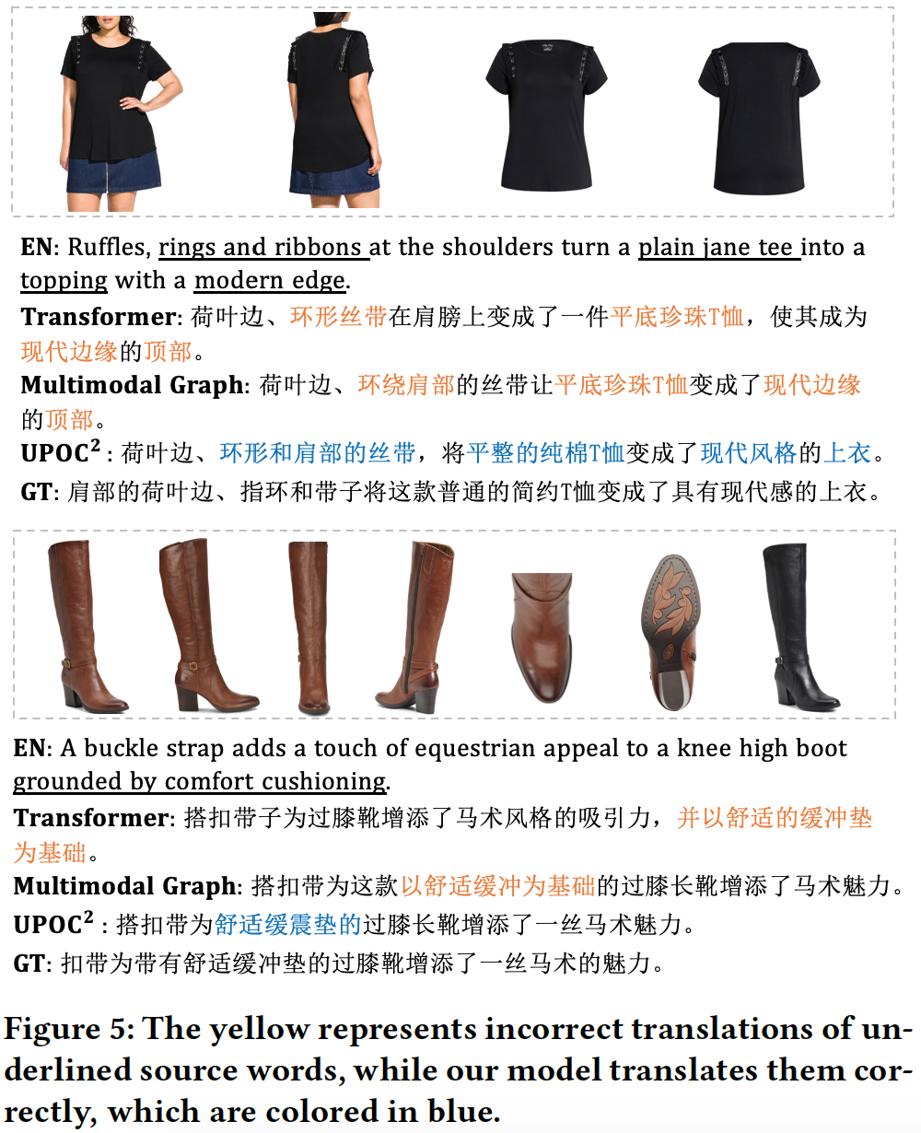
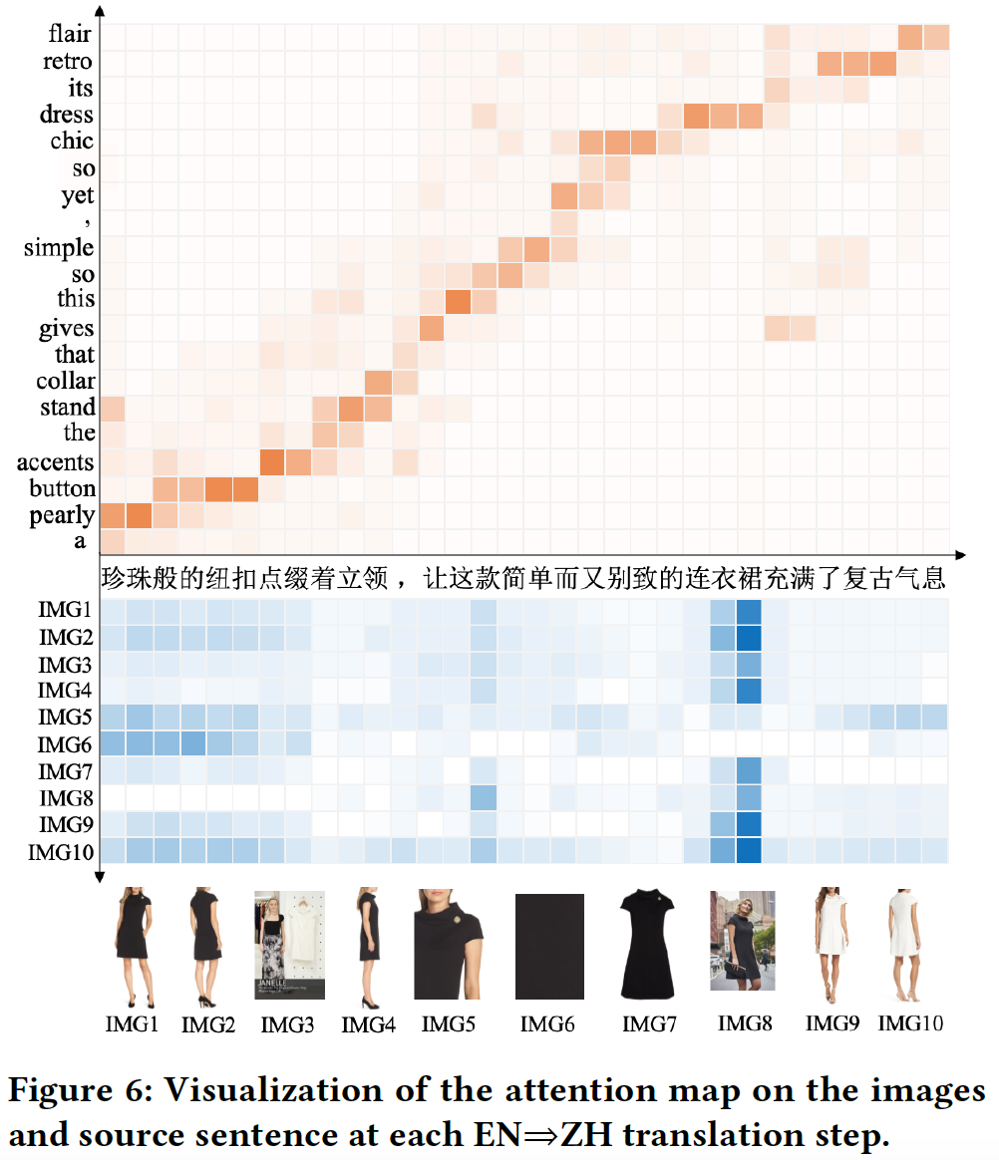
Visualization

Slide 25
Summary
We construct a large-scale bilingual MMT dataset called Fashion-MMT for the product-oriented machine translation (PMT) research.
We propose a cross-modal cross-lingual pre-training model with three proxy tasks and achieves the state-of-the-art translation results on both the Fashion-MMT and Multi30k datasets.
We have released the data and code at https://github.com/syuqings/Fashion-MMT.

Slide 26
THANKS/感谢聆听
--------- Q&A Section --------
Email: syuqing@ruc.edu.cn

